Slide 1
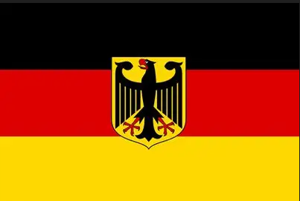

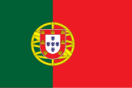

Morbey family tree german branch
version 2026_01_08
Gelebte Familienwerte
Ehre
Bereitschaft, sich für die Gemeinschaft einzusetzen
Vertrauenswürdigkeit
Standhaftigkeit und
Wehrhaftigkeit
Streben nach Wohlstand
Lived family values
Honor
Willingness to serve
the Community
Trustworthiness
Steadfastness and
intended to defend and protect
Striving for prosperity
Valores familiares vividos
Honra
Disposição para
servir a Comunidade
Confiabilidade
Firmeza e determinação
para defender e proteger
Procura pela prosperidade

Slide 2
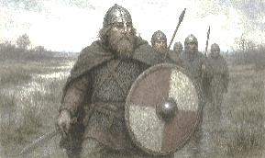
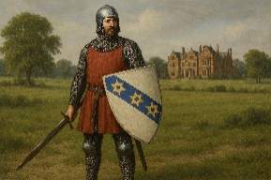
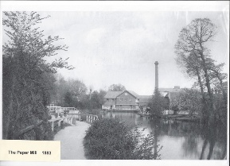
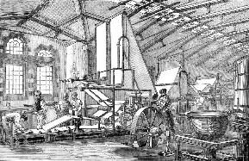
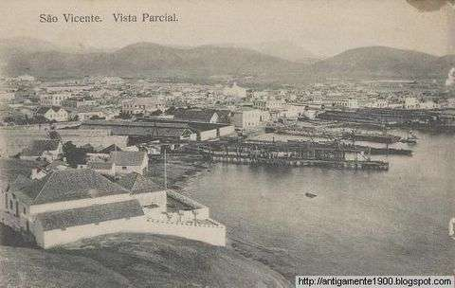
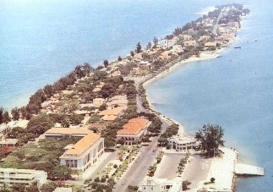

Morbey family tree german branch
01 Beginnings
Vikings and the Knight in UK
Probably from “Sweden” to Moorby and York
10th century ff
Ancestors England
Probably: Sir Robert de Morebey
Checked: John Morbey, Edwin John Morbey
02 Paper Makers
1760 - 1870 ff
Ancestors Cape Verde – Portugal
Pereira d’Eça, Ferreira
03 Steamships Era: Coal trade in Cape Verde
Morbey Portuguese Branch spread out
Cape Verde, Portugal, Angola, Mozambique
04 Morbey relatives from Cape Verde - Portugal
05 Railways Era:
Morbey Branch in Angola – Portugal
1905 – 1981
Ancestors Angola – Portugal (ca. 1850 ff)
Pereira de Lacerda, Gen. João de Almeida, Gen. Machado, Eng. Mariano Machado, Pinto Basto, Fernandes Costa, Rosado de Sousa
Ancestors Germany - Egerland (1758 ff)
Habermann, Köhler, Hermann, Hölzner
06 Information Technology Era ff
Morbey Branch in Germany since 1976
07 Other close family members
Attachments

Slide 3
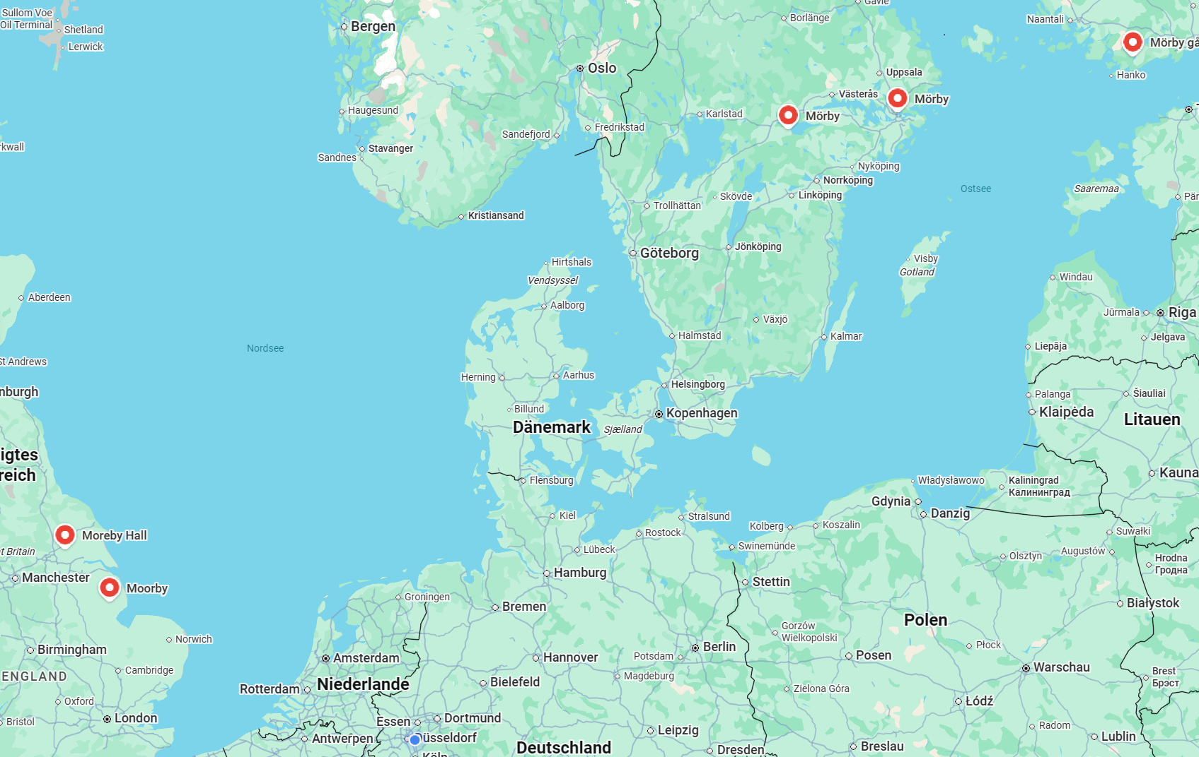
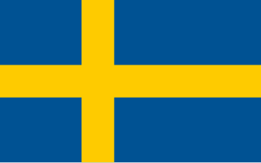
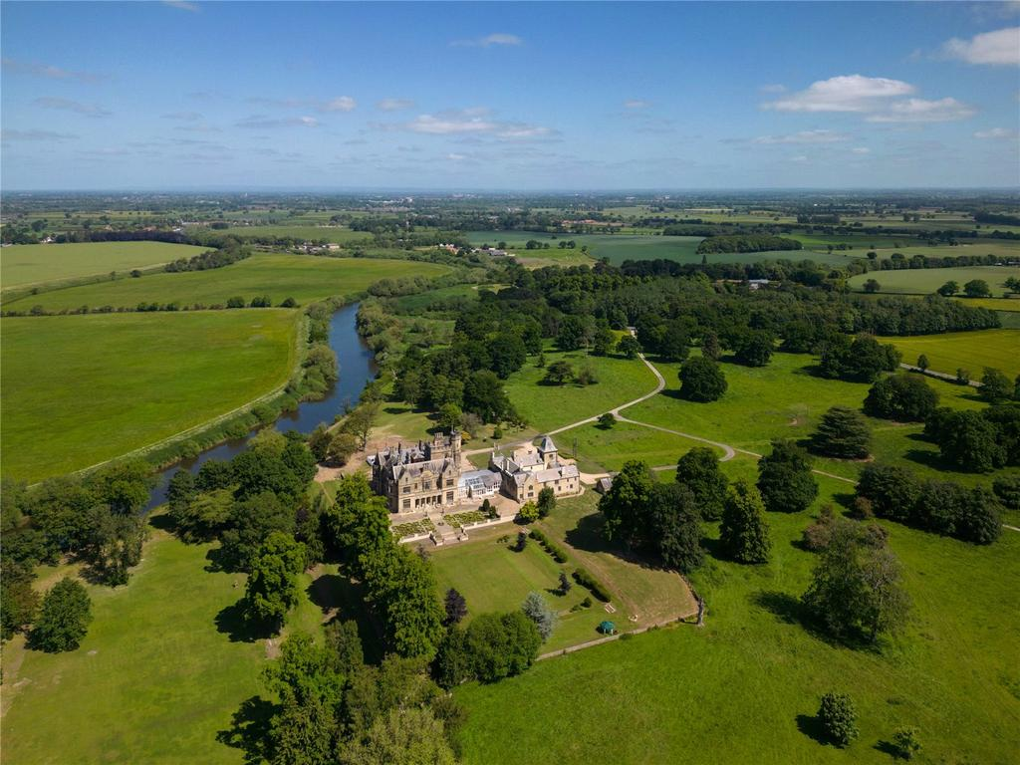
Morbey family tree german branch
01 Beginnings
Vikings and the Knight in UK
Probably from “Sweden” 10th century to Moorby.
At the time when York formed part of a Viking kingdom.
In the 1300s Moreby Hall was part of Sir Robert Moreby's estate when he retired from active life.
York

Slide 4
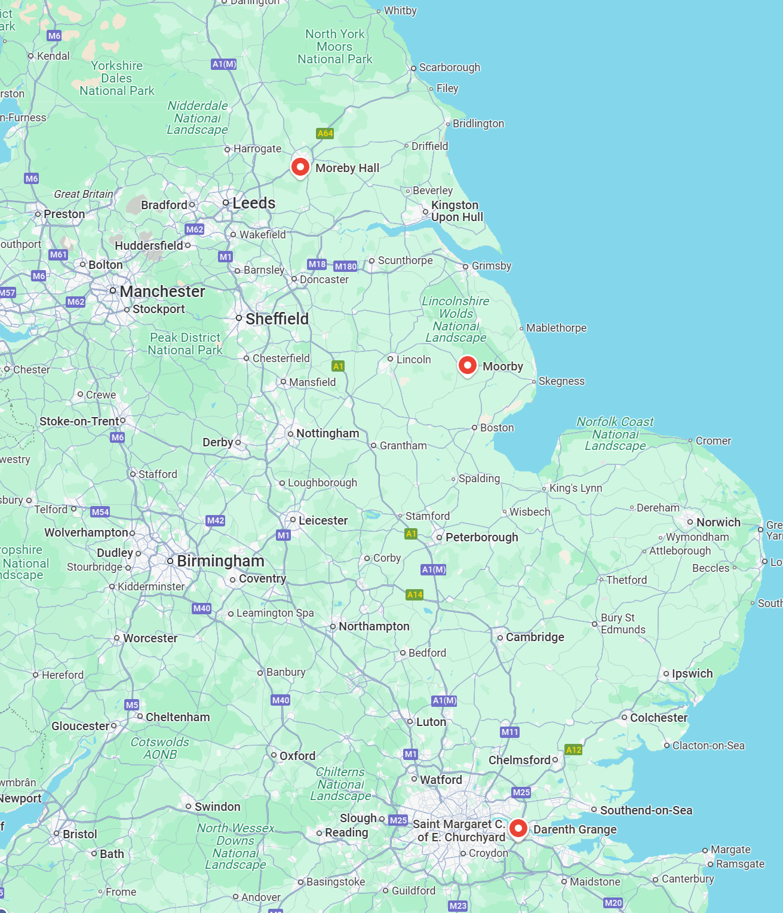
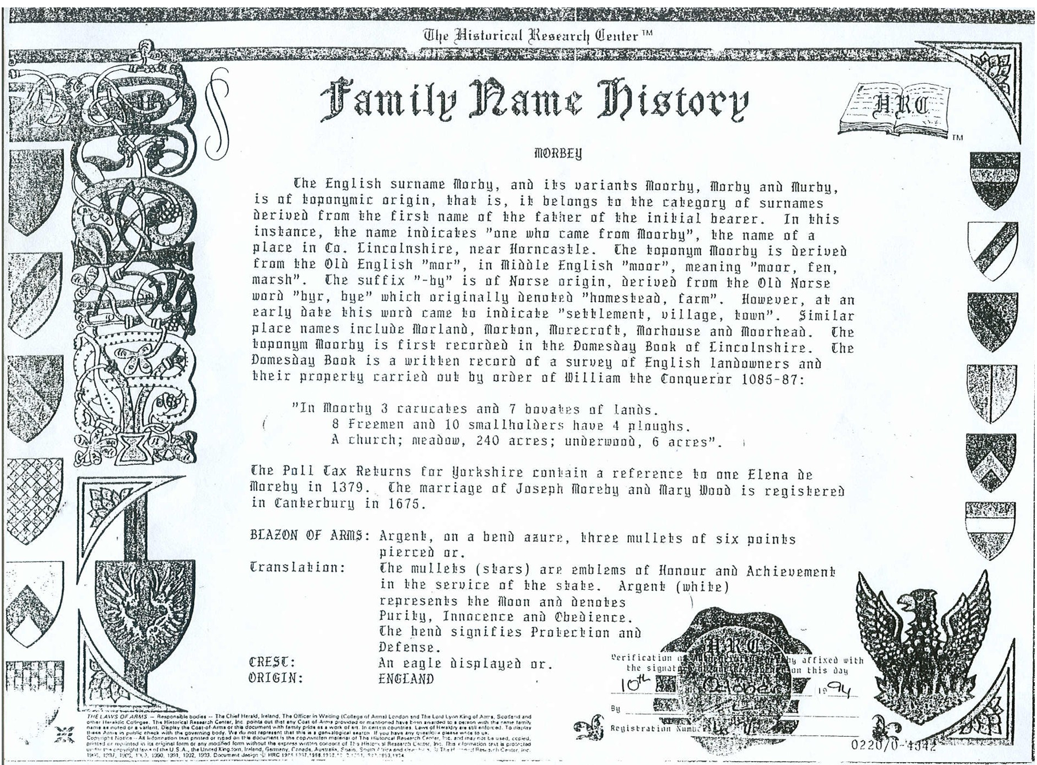
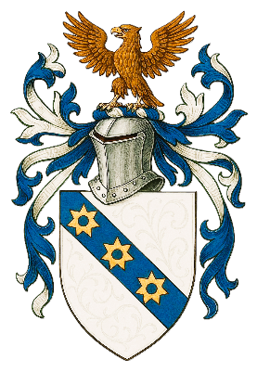
York
Sir Robert de Moreby
1272 – 1336
1085-87
London
John Morbey
1786 - 1842
Internal Use Only
Kent

Slide 5
Geschichte des Familiennamens
MORBEY
Der englische Nachname Morby und seine Varianten Moorby, Morby und Murby sind toponymischen Ursprungs, d. h. sie gehören zu der Kategorie der Nachnamen, die vom Vornamen des Vaters des ursprünglichen Hörers abgeleitet sind. In diesem Fall bezeichnet der Name „jemanden, der aus Moorby stammte“, dem Namen eines Ortes in der Grafschaft Lincolnshire, in der Nähe von Horncastle. Der Toponym Moorby leitet sich vom altenglischen „mor“ ab, im Mittelenglischen „moor“; was „Moor, Sumpf“ bedeutet. Die Endung „-by“ ist nordischen Ursprungs und leitet sich vom altnordischen Wort „byr, bye“ ab, das ursprünglich „Gehöft, Bauernhof“ bezeichnete. Schon früh bezeichnete dieses Wort jedoch „Siedlung, Dorf, Stadt“. Ähnliche Ortsnamen sind Morland, Morton, Morecroft, Morhouse und Moorhead. Der Toponym Moorby wird erstmals im Domesday Book von Lincolnshire erwähnt. Das Domesday Book ist eine schriftliche Aufzeichnung einer Erhebung englischer Landbesitzer und ihres Eigentums, die im Auftrag von Wilhelm dem Eroberer 1085-87 durchgeführt wurde:
"In Moorby 3 Carucates und 7 Buvates Land.
8 Freie und 10 Kleinbauern haben 4 Pflüge.
Eine Kirche; Wiese, 240 Acres; Unterholz, 6 Acres".
Die Steuererklärungen für Yorkshire enthalten einen Hinweis auf eine Elena de Moreby im Jahr 1379. Die Heirat von Joseph Moreby und Mary Wood ist 1675 in Canterbury registriert.
Wappen: es ist silber, auf einem blauen Band drei durch gebohrene (eingefasste)
goldene sechsstrahlige Sterne.
Übersetzung: Die Sterne sind Abzeichen der Ehre und der Erbringung von Diensten für den Staat. Silber (weiß) repräsentiert den Mond und steht für Reinheit, Unschuld und Gehorsam. Das Band bedeutet Schutz und Verteidigung.
Helmzier: ein goldener Adler (Symbol für Macht und Wohlstand).
Ursprung: England 10.10.1994
York
Sir Robert de Moreby
1272 – 1336
1085-87
London
John Morbey
1786 - 1842
Internal Use Only
Kent

Slide 6
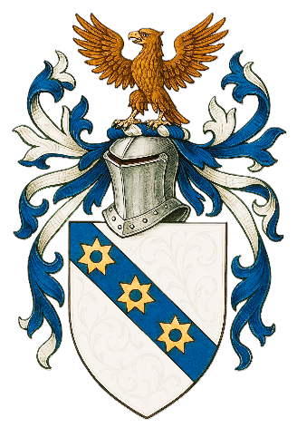

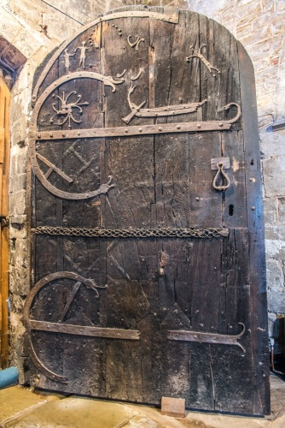
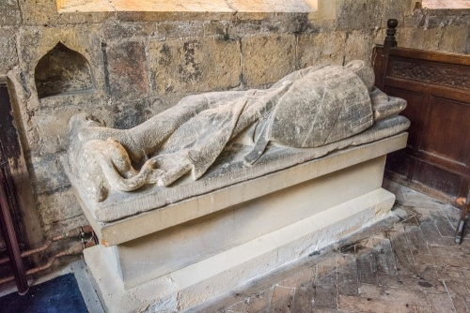
Sir Robert de Moreby
1286 – 1336 oder 1272 - 1335 (im Alter von 50-64)*
Der älteste Sohn von William de Moreby, Gutsherr von Stillingfleet. Er diente in Eduards II. Schottischen Kriegen von 1310 bis 1320 unter Lord Grey de Hotherfield. 1318 heiratete er Margaret, die Witwe von Lord John Grey und jüngste Tochter von William de Oddinfsells of Marstock, Warwick. Von 1321 bis 1323 war er Wächter von Breocknock Castle und hatte den königlichen Auftrag, die walisische Grenze gegen Rebellen zu verteidigen. 1322 zum Ritter geschlagen, begleitete er im folgenden Jahr Königin Isabellas Gefolge durch Frankreich. 1328 war er Gutachter des königlichen Haushalts in Berwick-upon-Tweed und wurde 1329 mit der Verantwortung für Burg und Hof von Knaresborough betraut. Er saß im Friedensausschuss von West Riding. Er wurde 1330 als Ritter der Grafschaft für Oxfordshire ins Parlament gewählt und saß 1331 erneut dort, diesmal als einer der beiden Abgeordneten Yorkshires. Nach diesem Dienst zog er sich nach Moreby zurück und wurde lebenslang von der Pflicht befreit, in Gerichts- und Geschworenengerichten mitzuwirken oder ein städtisches Amt zu übernehmen. Sein letztes öffentliches Erscheinen erfolgte 1335, als er beauftragt wurde, die Männer von Oxfordshire und Berkshire entsprechend ihrem Stand zu bewaffnen und auszurüsten. Er hinterließ einen Sohn und Erben, William, geboren um 1324.
*depending on the data source
Sir Robert de Moreby (1286 -1336) – Find a Grave Gedenkstätte
Other Morbey Branches
Sir Robert de Moreby KNIGHT (1272-1335) US Branch
Morbey Genealogy | WikiTree FREE Family Tree
Yorkshire village of Stillingfleet, St Helen's Church
MORBY Family USA
Soham Grammarians: Beechurst House
The Viking doorway, c. 10th century? @ the Moreby Chapel

Slide 7
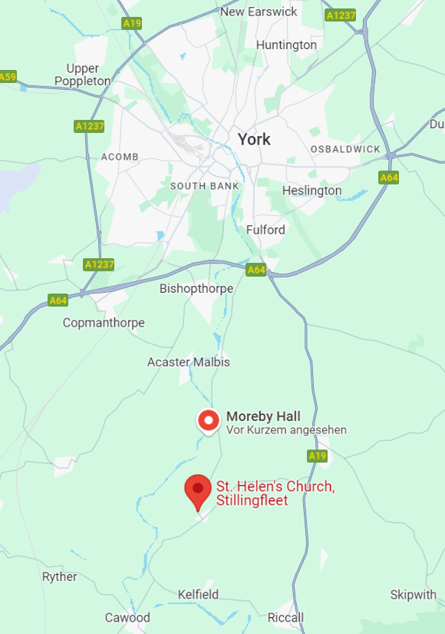
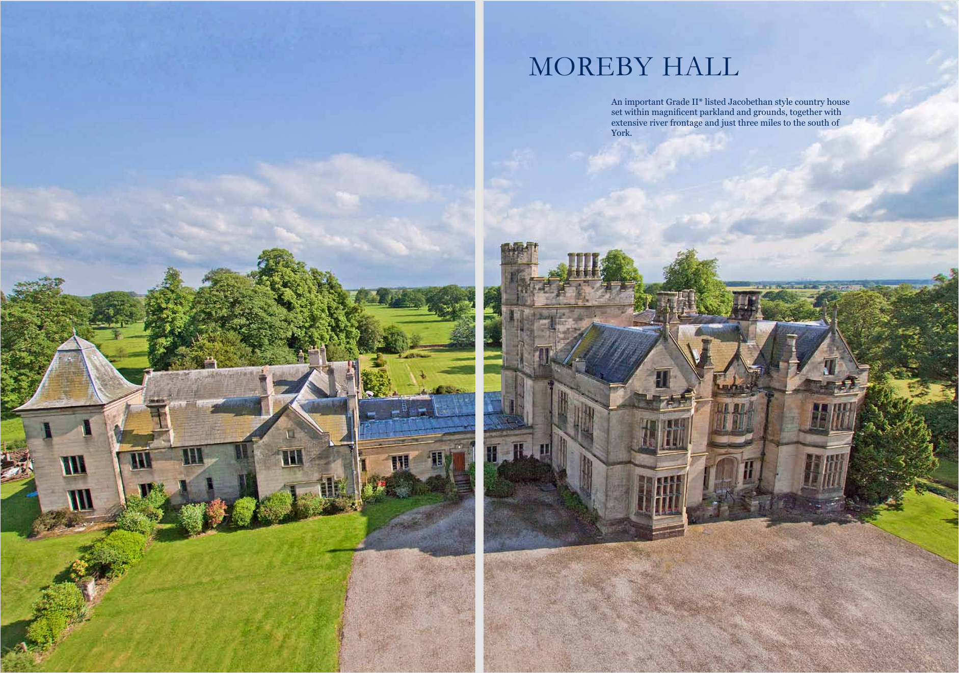
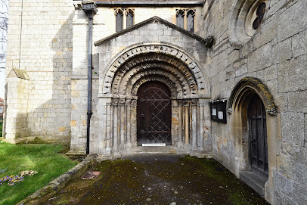
For family members
Est. 1832
Sir Robert de Moreby (64)
1272 – 1336
Sir Robert de Moreby (1272 -1336) – Find a Grave Gedenkstätte
Yorkshire village of Stillingfleet,
St Helen's Church
The Moreby Hall Estate
@Moreby Chapel
On the market -- pdf
Internal Use Only

Slide 8
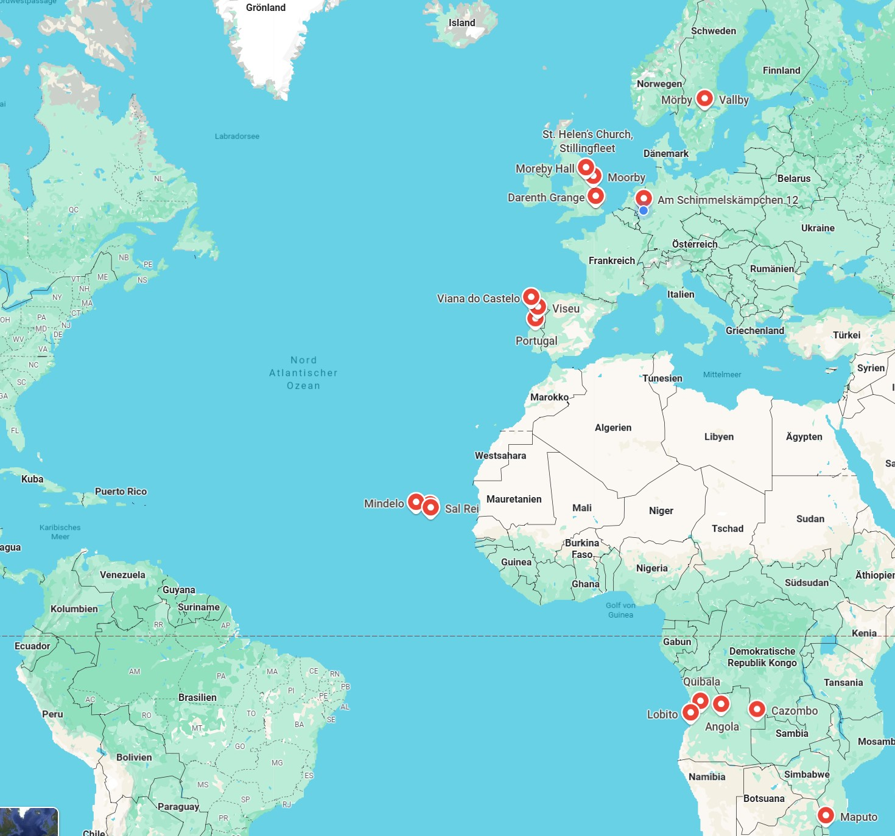
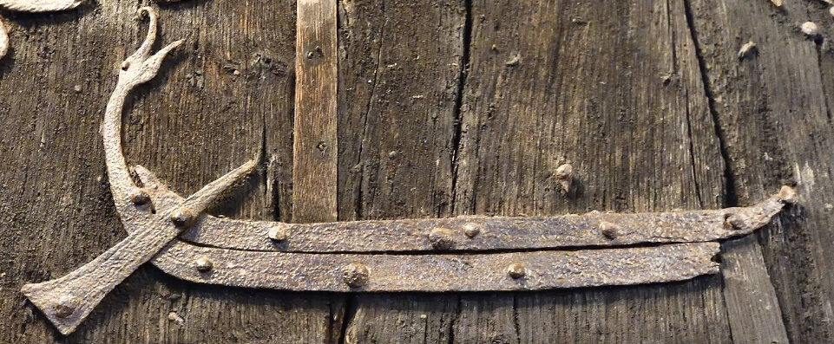
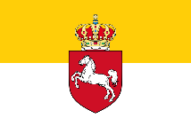
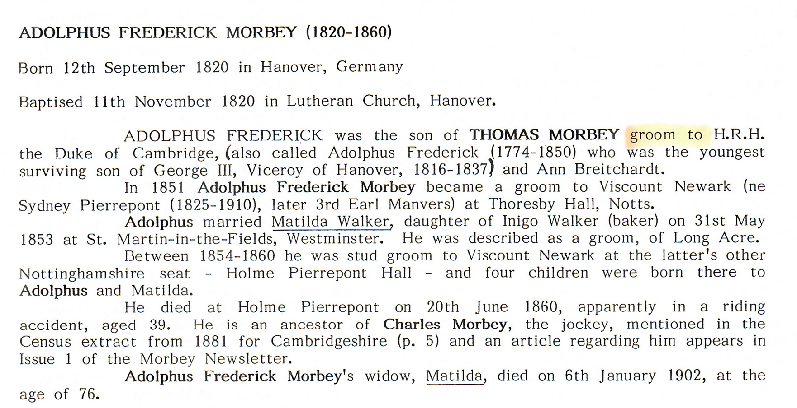
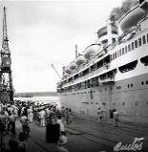
For family members
Morbeys in Germany
≈ 900
1st Generation
Thomas Morbey in Hanover, around 1820
1250
1085
1760
Hanover 1820
1864
1976
1800
1920
1974-80
2nd Generation
following the marriage of Guilherme and Brigitte in 1977 in Lisbon. They initially lived in Herzogenaurach, Bavaria,
where Brigitte has lived ever since.
1905
1930
1910
Internal Use Only

Slide 9
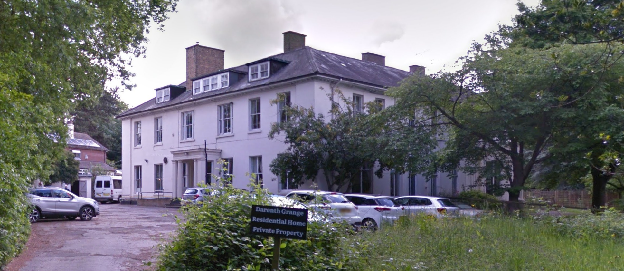
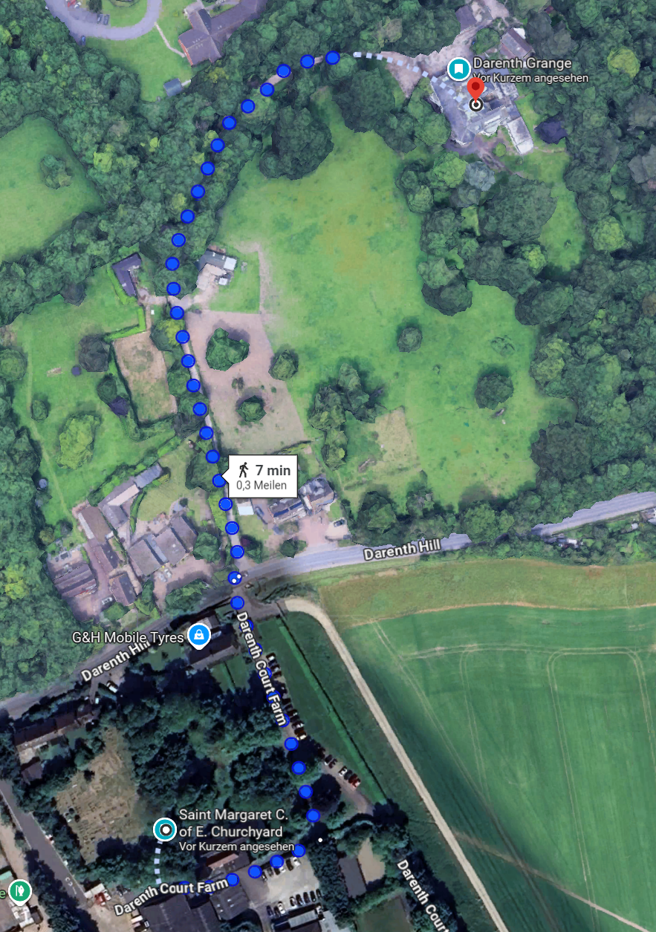
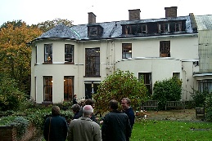
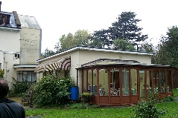
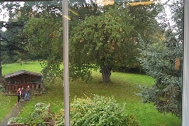
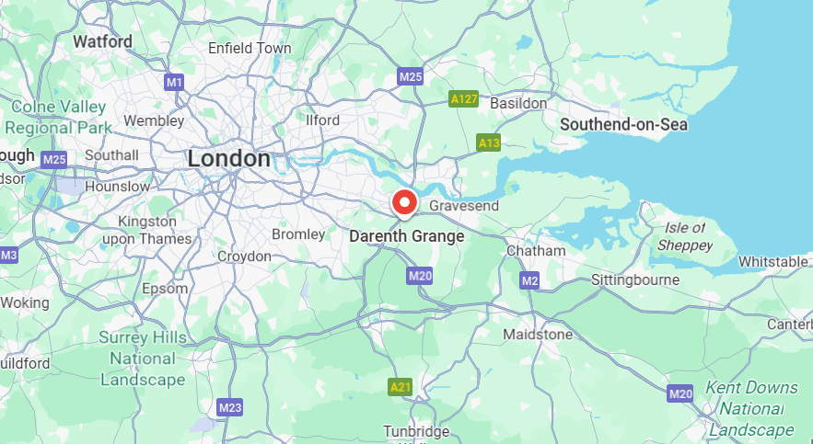
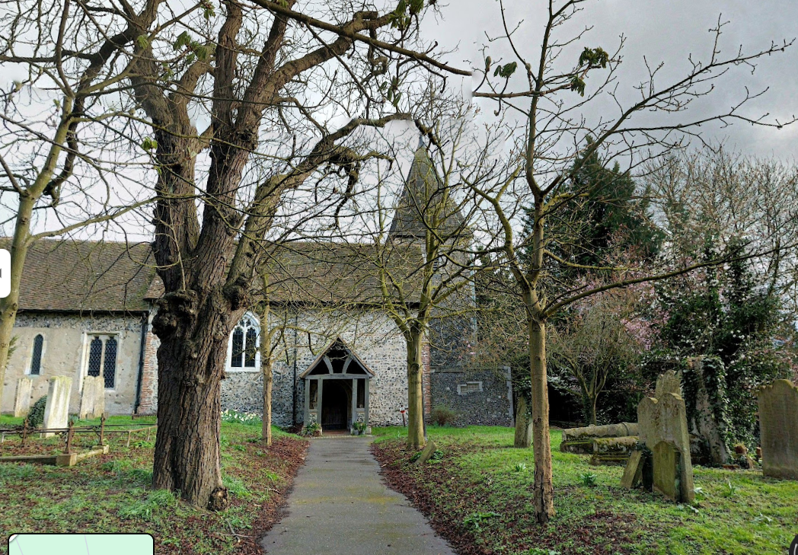
Morbey family tree german branch
House of John Morbey in Darenth, Kent
Special Feature
The watermark "John Morbey 1838" is a historical watermark applied to a document from 1840. It originates from a Darenth paper mill in Dartford, Kent, and is part of a large collection of watermarks available in various databases. These watermarks are important for identifying and dating historical papers and can provide information about the origin and period of use of the paper.
02 Paper Makers
1760 - 1870 ff
Dartford

Slide 10


Samuel Morbey (89)
b 1763 d 1852 Aynhoe, Northamptonshire
Ann
06.03.1810
Hardingstone
John Morbey (56)
b 1786 d 15.08.1842 Darenth, Kent
paper manufacturer for bank notes
1835 admitted to the
Freedom of the City of London
Last residence, grave
Ann Maria Bray (Morbey) (47)
b 1793 Brampton, d 3.01.1840 Darenth
Edward Morbey (63)
b 1789 Bladon, Oxfordshire
d 1852
paper manufacturer
Elizabeth Bray
KAS Kent Archeological Society
Edwin Morbey (57)
b 17.10.1813 Hardingstone, Northants
d 28.07.1870 Islington, Middlesex
Henry Morbey
b 1814
John Morbey (53)
b 1822/3 Hardingstone
d 1875 Westminster
Samuel Morbey
b 1826
Legend
date format b born d deceased
dd.mm.yyyy m married > children >> grandchildren
Eliza Morbey
b 1817
Anna Maria Morbey
b 1824 Darenth
Sophia Morbey
b 1830

Slide 11
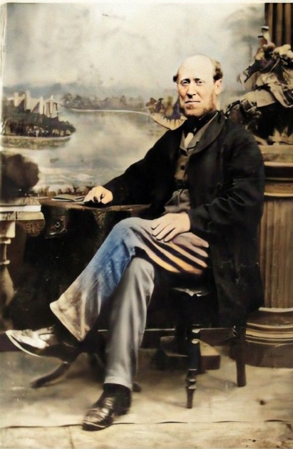
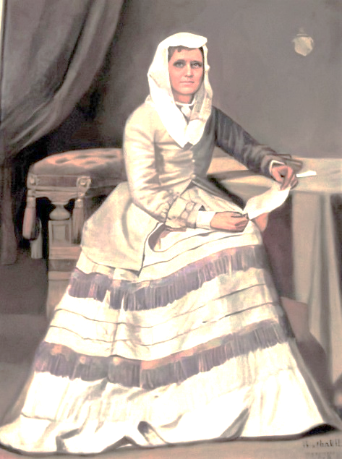
07.09.1840
Legend
date format
dd.mm.yyyy
b born
m married
d deceased
> children
>> grandchildren
Edwin Morbey (57)
b 17.10.1813 Hardingstone, Northants
d 28.07.1870 Islington, Middlesex
paper manufacturer
brewer‘s clerk
stationer's clerk
commercial traveller for a paper manufacture in Bristol
ff
Eliza M. Child (Morbey)
b 1822
Edwin John Morbey (36)
b 30.11.1841 Sundridge, Kent, England
d 01.12.1877 Mindelo, Cape Verde Islands
Gorge Foster Morbey (79)
b 1849 Chalford, Gloucester
d 1928 London
Eliza Sophia Morbey
b 1843 Sundrige
Mary Elizabeth Morbey
b 1850 Chalford
William Matthew Morbey (48)
b 04.1844 Sundridge, Kent
d 12.12.1893 Parkside, South Australia (Adelaide)
Thomas Harry Morbey
b 1853 Gloucester
Walter Edward Morbey (79)
b 1853 Bristol, d 1932
>> Edward Keith Morbey, Bengeo, Hertford
Aubert Charles Morbey
b 1846 Gravesend
Samuel Frank Morbey (39)
b 1847 Blackheath, d 1885
> b 1870 Ada Eleanor Morbey
Robert Osborne Morbey
or Robert Haynes Morbey?
b 1856/7 Bristol

Slide 12
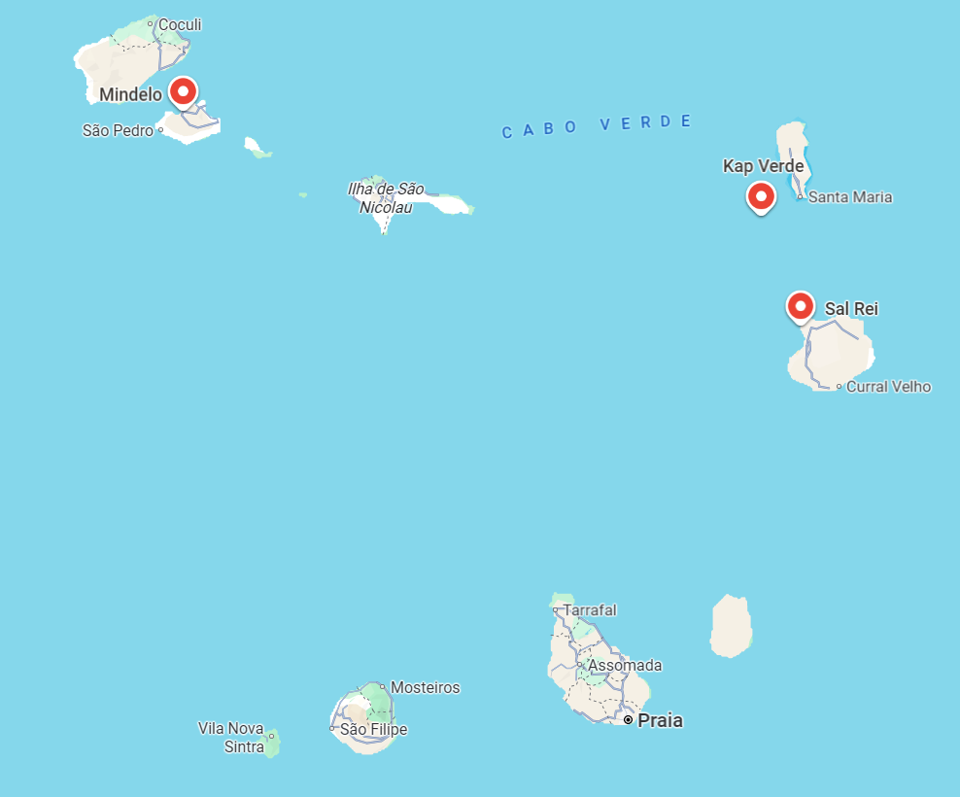
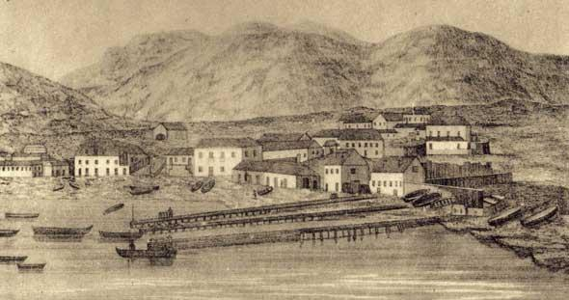
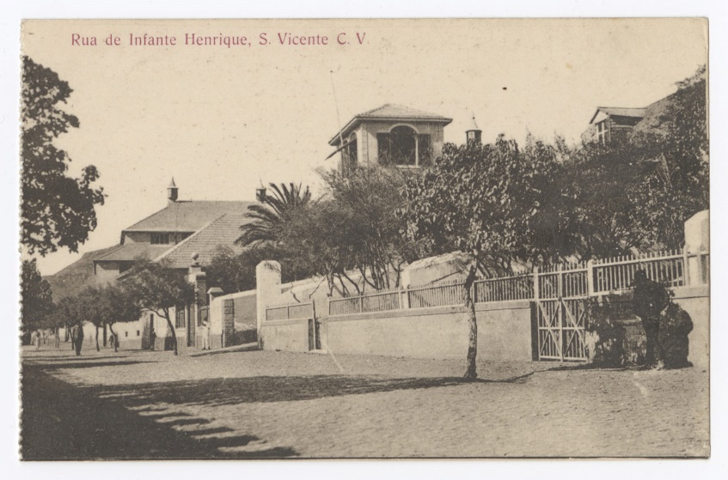
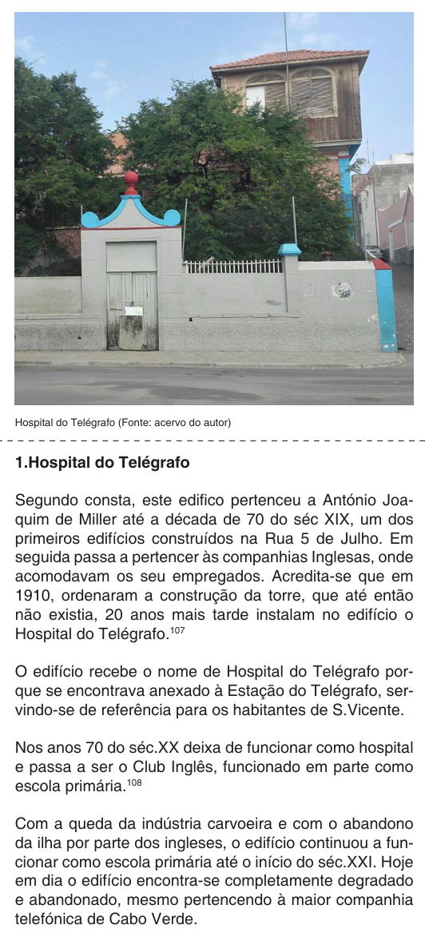
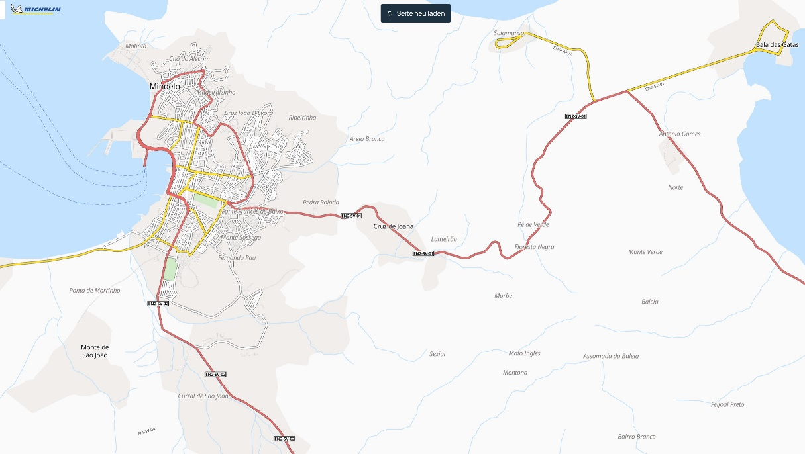
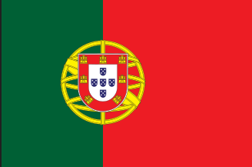
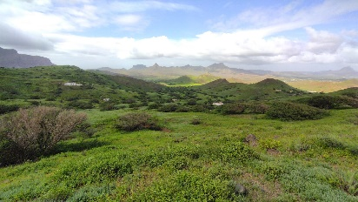
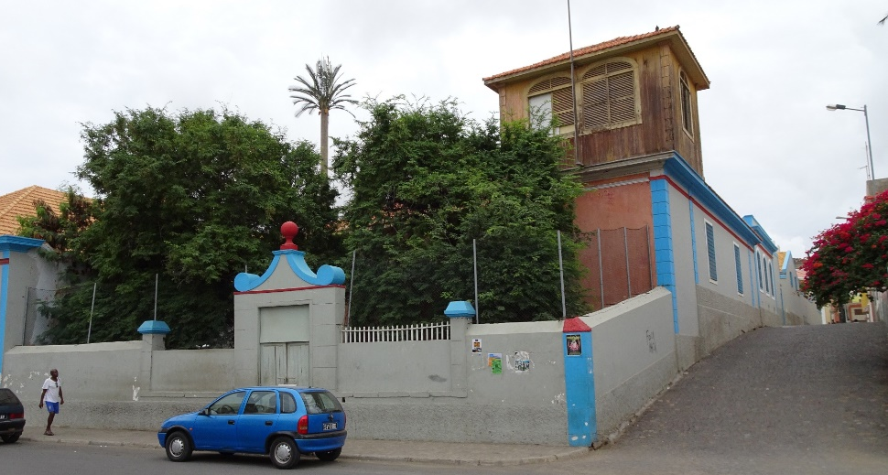
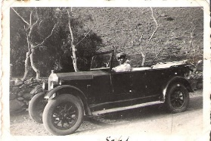
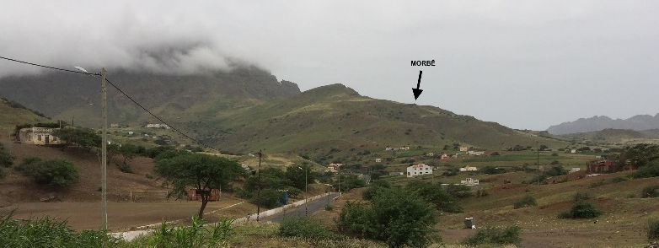
Morbey family tree german branch
Mindelo became a vital coaling station for steamships crossing the Atlantic, especially after 1850. The business of Millers & Corys was supplying these ships with coal.
03 Steamships Era: Coal trade in Cape Verde
Morbey Portuguese Branch spread out
Cape Verde, Portugal, Angola, Mozambique
City House of Edwin John Morbey in Mindelo, Cape Verde 1860
Edwin John Morbey works as accountant for Millers & Corys shipping coal and oil bunkering in Mindelo
City House
Pé de Verde - one thousand hectares
7,8 km from City House to Morbé
Morbé - Weekend House

Slide 13
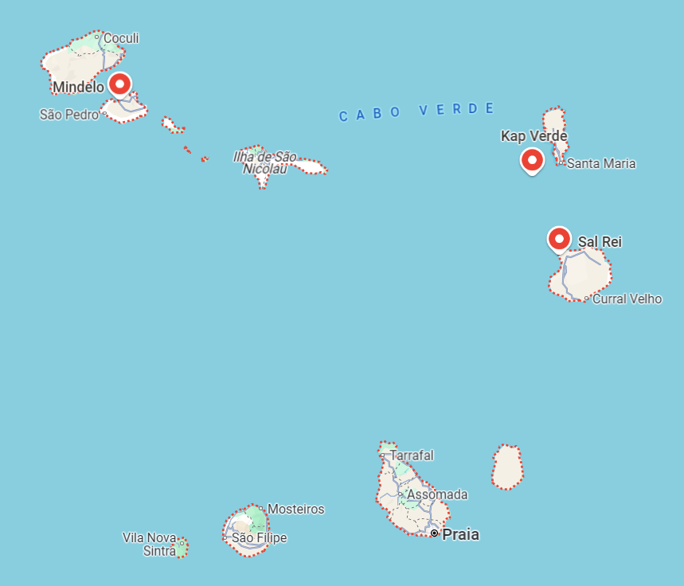
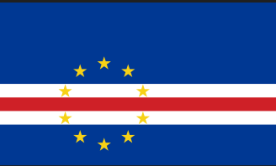
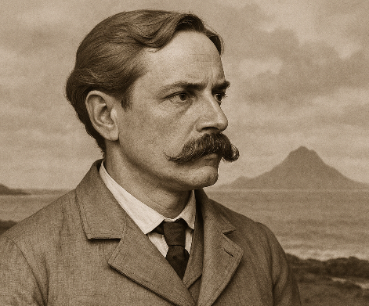
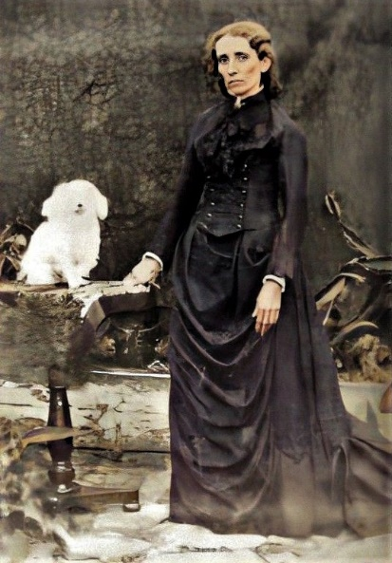

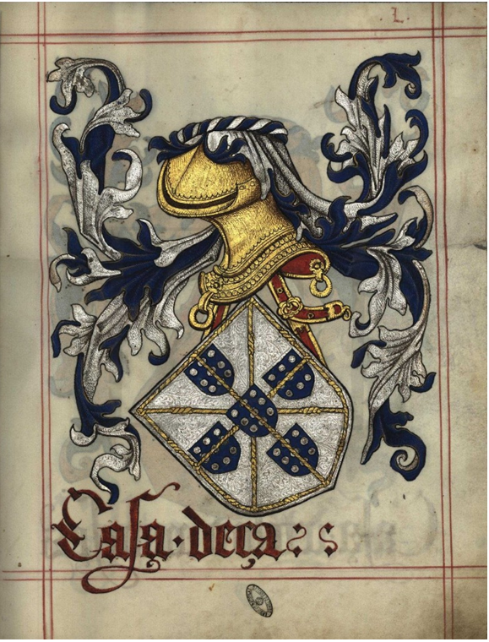
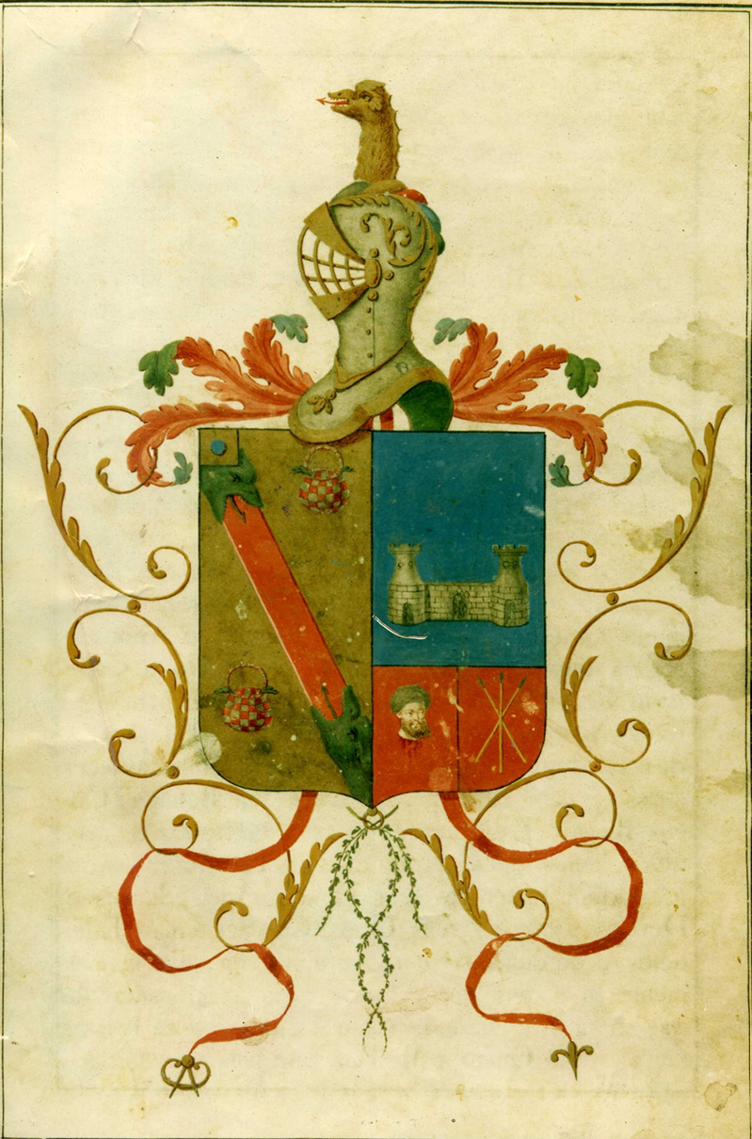
São Vicente, Mindelo
29.04.1865
Edwin John Morbey (36)
b 30.11.1841 Sundridge, Kent, England
d 01.12.1877 Mindelo, Cape Verde Islands
Book-keeping accountant for Millers & Corys Limited (carbon trade company)
03.1874 Honorary-Consul of Brazil, S. Vicente
03.1877 Vice-Consul of Belgium, S. Vicent
Property 1.000 hectares in Pé de Verde, S. Vicente
Notice
03.1874 Thomaz Macaulay Miller was consul of Germany and Russia and vice-consul of England
Inácia de Assunção Pereira d´Eça (Morbey) (43)
b 01.05.1845 Boavista
d 27.05.1888 Min­delo
Eliza Winifred Morbey (Arrobas) (94)
b 1866 Mindelo, d 1960 Lisbon
Known as Tita,
m Cor. Caetano Maria Barreiros Arrobas
Charles Arthur Morbey (47)
b 1872 Mindelo, d 1919 São Vicente
m Adelina Ferro Coimbra
> b 1905 d 1990 Winniefried Florence Morbey
>> Maria Fernanda Morbey de Almeida
>>> b 1961 Carlos José Morbey Almeida Duarte Silva
living in Mindelo, Casa BENVINDO
m Luise >>>> Gabriel, Guilherme
Edwin d´Eça Morbey (23)
b 1867 Mindelo, d 1890 Mindelo
Consul of USA in Mindelo
Frank Bertram Morbey (23)
b 1873 Mindelo, d 1895 Mindelo
Thomas Macauley Morbey (79)
b 1875 Mindelo, d 1954 Lisbon
Guilherme Reginald Morbey (71)
or William Reginald Morbey
b 1869 Mindelo, d 1940 Lisbon
civil servant
Tereza de Jesus Alice Morbey (Afonso) (96)
b 1877 Mindelo, d 1973 Oeiras
m Maximiano José Leite Afonso
> José Morbey Afonso
> Edward Morbey Afonso
> António Morbey Afonso
> 1914 - 2010 Jorge Morbey Afonso (95)
Annie Florence Morbey (Ferro) (82)
b 1870 Mindelo, d 1952 Mindelo
m Benjamin da Silva Pinto Ferro

Slide 14




António Júlio Pereira d’Eça Freire e
Castro PIMENTEL (71)
b 14.03.1788 Sto Estêvão, Valença, Viana do Castelo
d 13.06.1859 Lisbon
Aniceto António Ferreira Alvares Mendes (77)
b 1753 Viseu, Portugal, seit 1804 in Kap Verde
d 1830 Boa Vista, Cape Verde
1787 Captain Major of Boa Vista
1803 Coat of Arms from El-Rei D. João VI de Portugal
Julio Cândido Ferreira
Boa Vista, Cape Verde
1830 Reafirmation Coat of Arms from El-Rei D. Miguel de Portugal
Casa d’Eça
António Julio Pereira d’Eça (36)
b 31.03.1819 Valença, Viana do Castelo, Portugal
d 17.11.1855 Lisbon
Military commander of Cabo Verde,
uncle of General Pereira d'Eça
Senhorina Cândida Ferreira (Pereira d´Eça)
b 1821 Boa Vista, Cape Verde
Inácia de Assunção Pereira d´Eça (Morbey) (43)
b 01.05.1845 Sal Rei, Boavista, Cabo Verde
d 27.05.1888 Min­delo, São Vicente, Cabo Verde
Casa Ferreira
António Júlio da Costa Pereira d’Eça (65)
b 31.03.1852 Lisbon, Portugal
d 06.11.1917
commonly known as General Pereira d'Eça – at the Portuguese Army, an administrator colonial and minister of War (1914-1915)
Arms of
Alvares
Arms of
Mendes
Ondjiva/Ngiva [Vila Pereira d’Eça]
Cunene, Angola

Slide 15






Morbey family tree german branch
04 Morbey relatives from Cape Verde - Portugal

Slide 16





Eliza, Gadinha, Oscar, Edith
Mindelo
6.04.1891
Guilherme Reginald Morbey (71)
or William Reginald Morbey or Dine
b 1869 Mindelo, d 1940 Lisbon
major Portuguese armed forces,
civil servant
Camila Rachel Bentubo Wahnon (Morbey) (83)
b 20.04.1872 Ribeira Grande, S. Antão
d 19.12. 1955 Lisbon
Camila, Beto, Guilherme, Tita
Eliza Winifred Morbey (Souto) (82)
b 1892 Mindelo, d 1974 Luanda
Olda Bertie Morbey (dos Santos)
1898 - d in Benguela, Angola
Edwin (John) Reginald Morbey (91)
20.06.1893 - 1984 Mindelo, Lisbon
also known as Dine
Ignácia de Assunção Pereira d’Eça Morbey, b 11.1903
Edmêa Florence Morbey (Rodrigues)
11.01.1895 Mindelo, 1960 Lisbon (65)
Hildegard Mabel
Morbey
b 03.08.1910
(also known as Gadinha)
Oscar Macaulay Morbey (71)
b 28.03.1897 Mindelo,
d 24.10.1968 Beira Mozambique
Walter Bertram Morbey
b 1913

Slide 17


Eliza, Gadinha, Oscar, Edith
Eliza Winifred Morbey (Souto) (82)
b 1892 Mindelo, d 1974 Luanda, known as Tita
> 1908 - 1987 Edith Alice Morbey (de Sousa Macedo Tavares), Mindelo, Oeiras (79)
>> Fernanda
> 1916 - 2012 (Beto) Alberto Nozolino de Azevedo, Luanda, Porto (96)
> 1917 - 2006 (Tita) Albertina Nozolino de Azevedo (Macambira), Santo Antão, Porto (89)
> 1926 - 2001 (Chinta) Jacinto Morbey Souto, Luanda, Lisbon married to São (75)
> 1929 - 2019 (Mia) Maria Helena Morbey Souto (Nunes Ferreira) Quibala, Oeiras (90)
> 1932 - 2022 Guilherme Morbey Souto, Quibala, Portugal (90)
m (Mela) Maria Amélia Rodrigues Gonçalves da Costa
>> 1966 - Rui Miguel da Costa Morbey Souto, Luanda
>>> 2002 - Nuno Noites Morbey, Porto
>>> 2003 - Ana Noites Morbey, Porto
>> 1967 - Isabel Alexandra da Costa Morbey Souto, Luanda
>>> 2006 - Eduardo Morbey Souto Vicente da Silva
>> 1976 - Ricardo Guilherme da Costa Morbey Souto, Porto
Camila, Beto, Guilherme, Tita
Edith and grand father
Guilherme Reginald
Legend
m married > children >> grandchildren >>> great grandchildren

Slide 18












Edwin (John) Reginald Morbey (Dine) (91)
b 20.06.1893 Mindelo, d 1984 Lisbon
also known as Dine
m (Dada) Eduarda (Wahnon) de Sousa Santos (Morbey) b 1895 Mindelo, d 1951 Luanda
> 1921 (Nocas) Edwin John Morbey
> 1923 - 1993 Edgard Reginald Morbey (70)
>> 1953 Miguel N. Ferreira Dias Morbey , lawyer, Luanda, Lisbon
>> 1954 Michaela C.; 1957 Paulo M.; 1960 João C. Ferreira Dias Morbey
> 1929 -2025 Aubert Bertram Morbey (surveying engineer) (96)
m Aida Afonso da Silva (b 1929)
>> 1952 Ana Maria Morbey (Conceição) Engineer, Lisbon
also known as Anita, married to Valdemar Conceição
>>> 1977 Carla Alexandra (Xana) Morbey Conceição
>> 1954 Carlos Eduardo Morbey (Dadinho), Luanda
veterinary, Sesimbra, m Lay
>> 1960 Luis Filipe Morbey, architect
> 1933 Maria de Lourdes de Sousa Santos Morbey
> 1935 - 2022 Guilherme José de Sousa Santos Morbey (Zeca), Mozambique (87)
married secondly to Alda Valente and had issue
> Aubert Reginald Morbey

Slide 19






Edmêa Florence Morbey (Rodrigues) (65)
b 1895 Mindelo, d 1960 Lisbon
married to Manuel Maria Rodrigues
> 1914 - 1985 Guilherme Morbey Rodrigues (71)
Praia Cape Verde, Rio de Janeiro, married to Vera (1942 - )?
>> 1963 Guilherme Morbey Rodrigues, Rio de Janeiro
>>> 1988 Ingrid Pinheiro Morbey Rodrigues
>>> 1990 Erika Pinheiro Morbey Rodrigues
> 1917 Manuel Morbey Rodrigues
> 1920 - 1988 Orlando Morbey Maria Rodrigues  in Lisbon (68)
former CEO of Philips and of TAP Portugal
> 1922 Maria da Graça Morbey Rodrigues
Edmea married secondly to ? and issue
> 1927 Pedro Morbey ?, 1927

Slide 20





Oscar Macaulay Morbey (71)
b 28.03.1897 Mindelo, m Maria Madalena Bento do Santos
d 24.10.1968 Beira Mozambique
> Ruby Mabel Morbey
> Ethel Mary Morbey
> b 1933 Norma Grace Morbey (Lobo),
Mozambique and since ca. 2010 in Lisbon
>> Ana Morbey Lobo
>> Luis Morbey Lobo
>> Isabel Maria Morbey Lobo.
Olga Bertie Morbey (dos Santos)
1898 - died in Benguela, Angola
> 1923 - 1940 Maria Amélia died in Luanda (17)
> 1924 - Edith living in Lisbon
> 1928 - d Norberto Eduardo Morbey dos Santos
military heli pilot, married to Maria Alice
lived in Luanda and Lisbon Algés
>> issued one boy and one girl
> 19... Noémia died 5 years old w. scarlet

Slide 21




Annie Florence Morbey (Ferro) (82)
b 1870 Mindelo, d 1952 Mindelo
married to Benjamin da Silva Pinto Ferro
> 1891 - Guilherme Morbey Ferro
married to Libania da Fonseca
> 1894 - 1894 Jorge Morbey Ferro (0)
> 1895 - Beatriz Morbey Ferro (Medina)
> 1889 - 1938 Auta Morbey Ferro (Barbosa) (49)
> 1908 - 1969 José Morbey Ferro (61)
married to Julia Rosset
> 1913 - 1988 Irene Morbey Ferro (Ramos Pereira) (75)
1st married to José Ramos Pereira
2nd married to Victor Nogueira Gonçalves
>> Mª Fátima Gonçalves
>> 1956 Rui Alberto Morbey Gonçalves
>> 1914 - 1990 Benjamin da Fonseca Morbey Ferro (76)
>> 1916 - 2006 Annie da Fonseca Morbey Ferro (90)
>> Ilidio, Auta, Euridice, Dulce, Celest,
Teresa Jesus, Luis Gonzaga Morbey Ferro de Medina
>>> Jorge Alberto Morbey Ferro Ramos Pereira Medina, Eng. Pnt de Lima
>> 1921 - Annie Morbey Ferro Barbosa (Quintas)
>>> Auta Maria BQ, António BQ (Tomané) repr. Volvo in PT
>> Sebastião José, Kate, Olga Wanda, Benjamim Guilherme
(>>> Ana Paula (M.D, internist), Benjamin José, Cristina and Jorge Manuel)
Ilídio, Auta, Vasco Morbey Ferro
>> Laura Annie Morbey Ferro Ramos Pereira (82)
>> 1936 - 2013 José Manuel Morbey Ferro Ramos Pereira (77)
Comandant Morbey - TAP Pilot, Lisbon marr. o Ana Maria
F de Reimond >>> 1976 Monica F MP, J Morbey Pereira
>> 1938 Angelina Morbey Ramos Pereira
>> 1940 O* Ramos Pereira
>> 1942 - Jorge Morbey Pinto Ferro Ramos Pereira,
Mindelo, Lisbon, Macau, portugiese diplomat in Bangkok
>>> 1974 Jorge MRP, 1975 Lara MRP, 1977 E MRP
Ana
Jorge

Slide 22






Lobito
Morbey family tree german branch
1905
05 Railways Era:
Morbey Branch in Angola – Portugal
1905 – 1981
1975
1900
Ester with
Vasco Machado
Mariano Machado

Slide 23




1st. marriage
Thomas Macaulay Morbey (79)
b 22.05.1875 Mindelo,
d 01.02.1954 Lisbon
civil servant
1918 – 1926 Guiné Bissau
1924 – 1926 Secretário dos Negócio Indígenas
Eduarda Ferreira de Lacerda (Morbey)
b Luanda, father from Porto, mother from Luanda
Frank Bertrand Morbey
b 03.04.1906 Luanda, Angola
Edwin
Edwin Macaulay Morbey (52)
b 10.09.1908 Luanda, d 1960 Lisbon
2nd. marriage
Emilia Arrobas da Silva Azevedo (Morbey)
b 1895 São João Baptista, Brava Island, Cape Verde
Maria de Lourdes Azevedo Morbey (Machado)
b 15.02.1919 Brava Island, Cape Verde, went to Brazil
Carlos
Carlos Rui de Azevedo Morbey (70)
b 27.09.1923 Lisbon, d 25.04.1994 Sao Paulo, Brazil
3rd. marriage
?
Thomas Morbey
b ? Agriculture Engineer, 1989 lived in Cascais,
without children

Slide 24


António José Pereira de Lacerda
b ≈1850 São João do Santo, Braga,
or Porto, Portugal
Carolina Ferreira Lino
b ≈1850 Luanda, Angola
Coat of Arms of
Pereira de Lacerda
Eduarda Ferreira de Lacerda (Morbey)
b 1875 Luanda, father from Porto, mother from Luanda
Maria Helena da Cruz Teixeira
half sister of Edwin Macaulay lived together with him and took care of my father and my aunt and later on of me until I was four years old.
1959 she moved with my grand father and me to Lisbon.
1977 I saw her the last time and now I know she died in Alcantara by Lisbon

Slide 25



Frank Bertrand Morbey
03.04.1906 Luanda, Angola
> (Lola) Laura Alice Macedo Morbey (Azevedo) Luanda
married to João Azezedo CEO Coca Cola in Angola
>> One son died as a child due to an electrical accident
>> Another ? Morbey Azevedo died 2020* Barreiro
>> 13.05.1975 Carlos António Morbey, Angola
has been adopted by Lola and moved with her to Portugal
in the 1980ties. He was a brilliant midfielder Football player
1995-96 Carlos moved to Belgium

Slide 26









Branca, Madi, Nelson (1950)
1931 Luanda
Edwin Macaulay Morbey (52)
b 10.09.1908 Luanda, d 1960 Lisbon
Branca Correia Peres de Almeida (Morbey) (51)
b 29.03.1914 Lobito, d 30.03.1965 Benguela.
(Necas) Hildegard Correia Peres Morbey (50)
b 1931 Cazombo, d 1981 Lisbon
m Jaime Filipe dos Santos Oliveira
  > Jaime Filipe Morbey dos Santos Oliveira, b 1954 Lobito, d 1977 Lisbon >> Daniel ... Morbey... b 1976 Lisbon
Nelson de Almeida Cruz (31)
b 28.01.1942 Luanda, d 1973 in Maputo, Mozambique who lived some time with my father in Lobito.
m Stella, > Erika Cruz, Mozambique now in South Africa
(Méme) Guilherme Reginald Peres Morbey (68)
b 13.04.1933 Cazombo, d 2001 Setúbal
(Madi) Adília Marília Correia Costa Carneiro
b 16.06.1947 Luanda, now in Barreiro, Portugal
Oscar Correia Peres Morbey
1934 Ranhados, Viseu, was born death
(Zeca) José Olavo de Almeida Lima
b 1952 Luanda, now in Lagoa de St. André, Sines
m Minda Mendes and issued
> Gabi >> Bruna, Tiago
> Sérgio >> Mariana, Bruno, Xavier
> Pedro
At last, Branca lived with Vergilésio Ferreira Bernado, Fundição de Aços Ferros e Metais (steel, iron, and metal foundry), who was from Alcantara, Lisbon. They lived in Cubal and Benguela. Branca earned her living with a sewing machine.

Slide 27



Dembos Hero, Angola
Peres
Spain
Bonita Correia
Angola
1st relationship
Gen. João de Almeida (80)
b 05.10.1873 Vila Garcia, Guarda
d 05.05.1953 Lisboa
Mother of Eugénio (Maria ....)
Before he married
Laura Mendes Leite (de Almeida)
2nd relationship
1st marriage
1st relationship
Eugénio Maria de Almeida (49)
b 1895 Vera Cruz, Aveiro, d 1944 Aveiro
Adília Correia Peres (da Cunha Senra)
b Catumbela d Catumbela
da Cunha Senra
Ranhados, Luanda
Military topographer
Branca Correia Peres (de Almeida Morbey) (51)
b 29.03.1914 Lobito, d 30.03.1965 Benguela.

Slide 28















1st. marriage
3.09.1955
Lobito
Guilherme Reginald Peres Morbey (68)
b 13.04.1933, Cazombo, d 29.10.2001 Setúbal
Most time Lobito and Setúbal
Maria José Machado de Carvalho (Morbey) (81)
b 19.04.1934 Huambo, d 08.06.2015 Lisboa, St. António dos Cavaleiros
Guilherme José (Machado de Carvalho) Morbey
30.05.1956 Lobito, since 1976 living in Germany
2nd. Marriage
1962 Setúbal Lobito
Maria Alice Ribeiro Bartholo (65)
b 1943 Catumbela, d 2008 Cascais
Guiomar Patrícia Ribeiro Bartholo Morbey
b 27.01.1963 Lisbon, Medicin Reporter
3rd. Marriage
1971 Lobito, Setúbal
Nair (Bébé) Braz Rebelo Cabral (Morbey)
b Benguela, d Setúbal
João Carlos Rebelo Cabral Morbey
b 05.02.1974 Lobito, Setúbal pastry chef,
motorbikes representative
4rd. Marriage
29.04.1985
Setúbal
Paulo Jorge Rebelo Cabral Morbey,
b 02.11.1975 Benguela, Setúbal,
Wind energy, Team leader on Montage
Ana Bela de Pádua e Silva Rola (Morbey)
b Lobito, no children

Slide 29





António José Machado
Maria da Glória Marreiros
Francisco José,Joaquim J., João J., Mariano J., e Belchior J.
Mariano José Machado (61)
b 19.08.1862 d 04.04.1924 Lagos
Maria da Glória dos Santos (Machado)
Joaquim José Machado (78)
b 24.09.1847 Lagos, d 22.02.1925 Lisbon
Engineer, 1st. Director of CFB
Benguela Railways
(Lobito - Luaù (Congo) 1.348 km)
Jorge Henrique, Armando, Guilherme e Estela.
Guilherme assists is father at CFB
General, Governor of India and Mozambik
Mozambique Railways (Maputo – Pretória)
Vila General Machado – Camacupa (Angola)
Vila Machado – Nhamatanda (Mozambique)
Vilage Mariano Machado – Ganda (Angola)
Duarte Ferreira Pinto Basto de Carvalho
b 14.05.1888 Coimbra
(Ester) Estela dos Santos Machado (de Carvalho) (35)
1887 Figueira da Foz, 23.11.1922 Lisbon
2nd marriage
Maria Eduarda …
> Jorge …
Vasco Lobito Machado de Carvalho (75)
b 12.04.1910 São Sebastião da Pedreira, Lisbon
d 28.11.1985 Lisbon
Lived most time in Lobito
(Tadi) Cândida Carlota Fernandes Costa (Machado de Carvalho)
Certidão de Nascimento Manecos
(Zé) Maria José Machado de Carvalho (Amaral) (81)
b 19.04.1934 Huambo, d 08.06.2015 Lisboa, St. Ant. dos Cavaleiros
2nd married to Guilherme Guedes de Menezes Amaral
> Ana Cristina (Saraiva) b 05.08.1968 Lobito >> Diogo
> Maria João (Graça) b 21.06.1975 Lisbon >> Carolina 29.01.02
Ruy Machado de Carvalho
> M. Eduarda
> M. Fatima (Fati) >> Jorge (South Africa), ??
> M. Alice (Guedes Vaz) >> Gonçalo, Rui
(Milita) Maria Luisa (Ferreira Martins)
b 08.07.1935 Huambo
> Maria João (Câmera e Sousa) >> Ricardo, Filipa
> Anita (Luis Ângelo Sousa Pires) >> Diogo, Joana
(Babicha) Maria Madalena (Morais)
b 1936 > Vasco, Maria (Silveira Machado), Nuno, Tomáz

Slide 30



João Agostinho da Costa
Cândida d´Âssumpção ?? Fernandes (Costa)
Francisco Duarte de Sousa
Rita de Cássia ‘das Dores’ Rosado (de Sousa Duarte)
Rosado de Sousa
Leoniza dos Prazeres, Leonel Francisco, Lélia Carlota
Leónia Maria, Filomena de Jesus, Luís Filipe, Mariano Eduardo
Tia Bela
Mariano Eduardo Rosado de Sousa
b 1889 in Estremoz
Stela Bela Pinto Pamplona Côrte-Real (Rosado de Sousa)
b 1892 in Luanda
1908 Estremoz
José Agostinho Fernandes Costa
b 1881 Estremoz, Militar Sargent
Lélia Carlota Rosado de Sousa
b 1883 Estremoz
Cândida Carlota Fernandes Costa (Machado de Carvalho)
b 1909* Estremoz

Slide 31


Morbey family tree german branch
06 Information Technology Era ff
Morbey Branch in Germany since 1976
Sahri, Andreas
Kenn
Kindergarten
Brigitte, Guilherme

Slide 32
















Lisbon
15.07.1977
Guilherme José Morbey
b 30.05.1956 Lobito,
since Dez. 1976 in Germany,
In 1982 he received the German citizenship and
shortened his name for reasons of public interest
Brigitte Margarethe Habermann-Morbey
b 02.11.1951 Erlangen,
living in Herzogenaurach, Fürth, Nürnberg,
Sindelfingen, Riederich,
Kaarst, since 1998 Erkrath
Kenn Morbey
b 25.12.1982 Nürnberg, Erkrath
Sahri Yasmin Morbey
b 24.09.1984 Sindelfingen, Erkrath

Slide 33











(Luise) Aloisia Habermann (61)
b 03.10.1893 d 1954 Ebmeth (Rovná u Sokolova)
14.10.1947
Herzogenaurach
Anton Habermann (48)
b 21.03.1922 Schönlind, Egerland
d 07.06.1970 Herzogenaurach
Maria Habermann (born Köhler) (49)
b 19.04.1924 Dürnbach, Egerland
d 17.02.1973 Herzogenaurach
Horst Herbert Habermann
b 23.04.1948 Erlangen
Master of Technical Management (CCI)
Brigitte Margarethe Habermann
b 02.11.1951 Erlangen, m 15.07.1977
since 1998 in Erkrath
Psychologist
Manfred Ernst Habermann
b 02.05.1958 Erlangen
Dr. Ing. (PhD) Materials Science
Gerd Erhard Habermann (43)
b 30.01.1960 Erlangen
d 06.12.2003 Nürnberg

Slide 34

Johannes Martin Habermann (67)
b 20.10.1758 d 28.06.1825 Steinbach
Regina Habermann (born Gaßl) (69)
b 02.09.1748 Lobs (Lobzy in Březová)
d 17.12.1817 Steinnach
Johann Lorenz Habermann (64)
b 26.05.1787 d 15.08.1851 Steinbach
Anna Kathrina Habermann (born Mühlhans) (77)
b 01.09.1797 Ruditzsgrün (Rudolec)
d 29.05.1874 Steinbach
Josef Dörfler (58)
b 07.12.1824 d 23.11.1882 Ebmeth
Ludovika Dörfler (born Knobl) b 09.04.1834 d 14.01.1906 Ebmeth (72)
28.12.1852
Johann Lorenz Habermann (81)
b 01.12.1831 d 27.03.1912 Steinbach
Anna Habermann (born Reif) (74)
b 21.08.1831 d 17.04.1905 Steinbach
06.11.1883
Josef Habermann
b 14.03.1858 Steinbach
Maria Habermann (born Dörfler)(42)
b 03.01.1864 d 17.03.1906 Ebmeth (Rovná u Sokolova)
(Luise) Aloisia Habermann (61)
b 03.10.1893 d 1954 Ebmeth (Rovná u Sokolova)

Slide 35


Anton Köhler
b ca. 1810 Schönficht
Anna Köhler (born Schneider)
b ca. 1810 Schönficht
Johann Köhler (51)
b 06.08.1828 d 13.05.1879 Schönficht
Maria Josefa Köhler (born Reich) (77)
b 30.05.1828 Schönficht
Josefa Köhler (63)
b 06.11.1863 d 31.03.1926 Schönficht
Martin Schuster
b 27.04.1850 Maria-Kulm
Maria Schuster (born Mayer) (61) b 15.03.1857 d 19.1.1928 Dürnbach
22.01.1921
Friedrich Köhler (80)
b 31.03.1893 Schönficht
d 27.02.1973 Herzogenaurach
carpenter
Anna Köhler (born Schuster) (83)
b 05.11.1888 Dürnbach
d 10.02.1971 Herzogenaurach
Josef, Maria, Herbert
Maria Habermann (born Köhler) (49)
b 19.04.1924 Dürnbach, Egerland
Herbert + Berta Köhler (born Herold)
> Edeltraud, Isolde + Armin Schmidt (Herogenaurach)

Slide 36





Hattingen
02.05.2020
Sahri Yasmin Morbey
b 24.09.1984 Sindelfingen
Psycholgist, Data Quality Engineer
Andreas Morbey (born Hermann)
b 12.03.1982 Bochum Wattenscheid,
living in Gelsenkirchen, Essen and Erkrath
High school teacher sports and physics
Rio Don Morbey
b 14.09.2021 Essen
b Bum Bum Peng

Slide 37









Gelsenkirchen
01.02.1979
Monika Karin Hölzner
b 31.08.1957 Wanne-Eickel – Herne
Court clerk, Sports instructor
Günther Hermann (79)
b 27.11.1944 d 23.12.2023 Bochum Wattenscheid, Gelsenkirchen High school teacher for sports and math
Oliver Hermann
b 21.10.1981 Bochum Wattenscheid, Gelsenkirchen
Polisher
25.10.2014
Alexander Rennenberg
(born Hermann)
b 11.02.1983 Bochum Wattenscheid, Gelsenkirchen
Psychologist
Patrick Rennenberg
Andreas Morbey (born Hermann)
b 12.03.1985 Bochum Wattenscheid, Gelsenkirchen
High school teacher for sports and physics
Thomas Hermann
b 30.12.1986 Bochum Wattenscheid , Gelsenkirchen
Material tester
01.10.2003
Hans-Jürgen Escherlor
b 07.10.1953 Waldheim, Gelsenkirchen
civil engineer

Slide 38


Slide 39




Morbey family tree german branch
Ferreira Martins / Sousa Pires ....
Tia Milita
07 Other close family members
Maria João
Guilherme
Anita
Luis Ângelo
Lisbon
Lima
Zeca
Bruna
Sérgio
Gabi
Lea
Akili
Minda
Sines

Slide 40






Horst Habermann
b 23.04.1948 Erlangen
married to Christine Habermann (born Reiß) b 03.04.1949 Münchaurach
> Manuela Storl (born Habermann) b28.12.1968 Fürth
>> Elena Storl b 29.11.1999 Neustadt an der Aisch
  Manuela is now living with Bernd Wetzel
Herzogenaurach Area
Manfred Habermann
b 02.05.1958 Erlangen
married to Manuela Habermann (born Brandl) b 02.06.1959
  > Roxanne Alt (born Habermann) b 02.03.1982 Fürth m Florian Alt (b 16.06.1977 Fürth)
    >> Maxima Alt b 11.04.2007 Erlangen
    >> Felix Alt b 27.04.2008 Erlangen
    >> Alexia Sophie Alt b 27.04.2017 Erlangen
  > Axel Habermann b 22.02.1991 Erlangen m Mona
    >> Lars Habermann b 03.01.2023 Schweinfurt
  > Tim Habermann b 24.11.1993 Erlangen m Melanie

Slide 41












1973 Tundavala, Angola
Guiomar Patrícia Morbey b 27.01.1963, Lisbon
> Bernardo Cunha e Silva b 22.1993 Lisbon
Lisbon / Setúbal
Ana Cristina Amaral b 05.08.1968 Lobito
> Diogo Saraiva b 12.02.2003 Lisbon
1973 Lobito
João Carlos Morbey b 05.02.1974
m Sónia Maria do Vale Costa Morbey b 17.04.1972
Maria João Amaral Graça b 21.06.1975 Lisbon
> Carolina b 29.01.02 >> Gabriel b 12.06.2024
Paulo Jorge Morbey b 02.11.1975 Benguela
m Daniela Lopes Morbey b 28.10.1977 Setúbal
> Nair Lopes Morbey b 13.09.2005 Setúbal
> Guilherme Lopes Morbey b 28.08.2011 Setúbal

Slide 42










Vasco Machado (grandfather)
Morbey family tree german branch
1969
Guilherme
(father)
Guilherme
(son)
Attachments
15.07.1977
Lisbon
São + Jacinto
Morbey Souto
Zé
Leana
Morgado
Vera
Costa
Jorge Morgado
Ana Cristina
Patricia

Slide 43

25.03.1925
GAZETA DAS COLONIAS
MARIANO MACHADO
Our Gazeta must today mourn yet another loss, and an irreparable one: Mariano Machado. Death took him unexpectedly, brutally, in just a few hours of struggle, after having been at our side, still working for the happiness of one of the colonies to which he had devoted, with the spirit of an old-fashioned Portuguese patriot, the best part of his hard-working life.
Mariano Machado was not only a man of merit, who had worn out his shoulders producing work; he was, above all, a soul full of virtues, consumed in defending an ideal. Military expeditions tore from him cries of pain. They tortured him as wasteful follies in a house of misery—devouring gold, consuming lives that would be needed for the production of the land.
His policy was that of the railways. He preferred the peaceful and lasting occupation of the locomotive to the aggressive and fleeting domination of the cannon. He translated into kilometers of railway track the immense sums spent on military operations, and he demonstrated that we would already have had the whistle of the steam engine across all overseas lands if, instead of consuming munitions to subdue the “native,” we had acquired rails to bring them services and bind them to us.
A patriot of the highest quality, not even when subordinated to foreign companies did he ever cease to be entirely and purely Portuguese. The one who writes these lines will never forget the passionate support Mariano Machado gave when, in the government of Moxico, he was obliged to dissolve the “military post” of a British officer, who, in the service of “Tanganyika Concessions,” had forgotten that he was operating… on our territory. And everything he touched with his hands became an instrument of prosperity through his labor. So it was in Mozambique. And even now he had shown it again through the hinterland of Angola.
An intelligent activity, which knew how to unite the brain to the rough work of the hand, always yielded perfect results from his efforts. His tireless sowing along the margins of the Benguela Railway was enough to have his name engraved in letters of gold.
The Gazeta das Colonias knows well that men like Mariano Machado are difficult to replace and that their disappearance almost always leaves an empty place. For this reason, we lay upon his memory this palm of homage, moistening it with the tears of our sorrow.

Slide 44


Railway Gazette Lisbon, June 1953
General Joaquim José Machado
A few weeks ago, the Lisbon Geographic Society paid a heartfelt and deserved tribute to the memory of the great colonialist and railwayman, General Joaquim José Machado. He is almost exclusively credited with the construction of the Lourenço Marques to Pretoria railway—with the inauguration of a bust, created by the illustrious sculptor Raul Xavier.
Regarding this tribute, the Algarve press, namely "Jornal de Lagos" and "Correio do Sul", presented and defended the idea of inaugurating a commemorative plaque in Lagos, in the house where General Machado was born. They also proposed placing a replica of that monument in a public square in the same city.
General Joaquim José Machado was a great national figure. In Angola, three monuments have already been erected in his honor, in addition to giving his illustrious name to the old village of Camacupa. And, as the "Correio do Sul" recalled, the English government, which is always so sparing in its consecrations to foreigners, also gave the name of "Machadodorp" (dorp, in English, means village) to a large part of the region served by the Lourenço Marques to Pretoria railway.
Born in the Algarve, the General, as you can see, is not a forgotten figure for the people of the Algarve, who greatly prize their most eminent figures. The attitude of the "Jornal de Lagos" and the "Correio do Sul" is extremely commendable. It reflects a regionalist sentiment worthy of note.

Slide 45
HOW LOBITO GAVE ITS NAME
AND DOUBLE NATIONALITY
TO A LITTLE “ALFACINHA”
On April 12, 1910, a boy was born in Lisbon, who would be baptized at the Church of St. Sebastião da Pedreira. In the parish records, his name was entered as Vasco Machado de Carvalho, son of Duarte Ferreira Pinto Basto de Carvalho and D. Ester dos Santos Machado.
At that time, his paternal grandfather, Mariano José Machado, had settled in Lobito, serving as representative and director of operations of the Benguela Railway Company. Longing to have his dearest relatives near him, he managed to instill in his son the idea of trying his luck in Angola, guaranteeing him employment in a newly created public office.
When Duarte disembarked in Lobito, accompanied by his wife and little Vasco (barely six months old), he was promised a position as head of the local Civil Registry Office, with the responsibility of setting it up. Once the office was opened to the public, the official waited for the first client to appear. Considering that someone had to be the first, he thought it fitting that it should be his own son. And so it was: he began the registry of births with the inscription of little Vasco, who thus received double nationality and an extra surname—Lobito—as a tribute to his adopted land. From then on, officially, he was called Vasco Lobito Machado de Carvalho, although in daily life he was simply known as Vasco Machado.
It is to the memory of this late son of Lobito that we dedicate these lines, absolutely well-deserved and, more than deserved, heartfelt. He was a citizen always present and a devoted friend of that land that had every right to consider him one of its own.
Vasco Machado was an active, dynamic, and entrepreneurial man. After 12 years of service at the Benguela Railway as a clerk, he moved on to other activities: sales manager, merchant, warehouse operator, and, finally, insurance agent. In all these roles, he showed a remarkable capacity for work, competence, and honesty.
A great sports enthusiast, he was without a doubt one of the most eclectic athletes in Angola. He practiced football (with Lobito Sports Club and Nova Lisboa Railway Club), athletics, tennis, roller skating, golf, swimming, acrobatics, car racing, and motorcycling with sidecar.
He was one of the founders, first pilot, and instructor of the Lobito Aero Club, of which he served as president for 10 consecutive years. He was also a key promoter of car racing events at Restinga, and played an important role in the creation of the Lobito Carnival, along with Francisco Melo and the Osório family.
Vasco Machado returned permanently to Lisbon on September 15, 1975, and passed away on November 28, 1985, at the age of 75. He did not see the end of life as a loss, but rather as a passage to the “other side,” with the peace of having fulfilled his mission and served the land that had given him the name LOBITO.
“O Lobito” magazin 1986

Slide 46

Guilherme Morbey
(13 April 1933, 1:00 AM – Cazombo, Angola – ✝ 29 October 2001, around 9:00 AM – Setúbal, Portugal)
Everyone who passes through this world has their own story, their dramas, and their successes. “Morbey,” as he was simply known, truly had a lot of all of that.
“Morbey” went to Lobito at a very young age, when his father Edwin Macauley joined the staff of the CFB (Benguela Railway). Many years later, “Morbey” also had his first job there.
As a child, he was mischievous, often went barefoot, went to school in Catumbela, and bore on his back the marks of the beatings he and his friends got at home—the unusual effort of their families to ensure that these “second-class whites” would straighten up and become useful members of society. When one of his childhood friends visited him, he always enjoyed listening again to those youthful adventures, which, despite the “horsewhippings,” still made them laugh out loud even in their forties.
Although “Morbey” was Catholic and a believer, I cannot deny that what gave him the most strength was sports, which he practiced until his last days. Through sport, and especially swimming in Lobito and Angola, he became known. He was the first man to cross Lobito Bay, the first Angolan to participate in the Olympic Games (Rome 1960), etc. “A sound mind in a sound body”—for him, sport went beyond physical exercise: even more important was the moral education of the athlete and the example/contribution to society. (Who doesn’t remember his swimming schools with nearly 150 children and young people?) Both as an athlete and a coach, he nurtured the spirit of teamwork in a sport of individualists and had great influence on the youth of Lobito. When the Portuguese government decided not to send a swimmer to the national championships, even though they had a good chance of winning medals, he organized dances and asked Lobito’s businessmen for money so that those who had trusted him would not be disappointed after a year or more of training. His friends in Lobito recognized his dedication, and his swimmers became proud little ambassadors of Lobito, Angola, and Portugal.
Associated with “Morbey,” who was a handsome man, were his four marriages along the CFB line between Lobito and Benguela. From his first three marriages, he left four children and, to this day, three grandchildren. Even though he had his struggles with the mothers, each child knew they were very loved by their father. His prayers that his children might have more success in their marriages were heard up above.
In 1980 he moved permanently to Portugal and, for the second time, ended up in Setúbal, where 20 years earlier he had created the swimming section at the Clube Naval Setubalense and inaugurated the first—and still the only—swimming pool in that city. In Setúbal, he was widowed and struggled to raise the two youngest children from that marriage. His pride, during that phase of his life, only allowed very few friends to give him a hand.
In his last years in Setúbal, he worked independently as a representative for furniture factories from the north and dedicated himself much more to family. He was the “soba” (chieftain) of the Morbeys. A severe attack of depression took him from this life. On the morning when the funeral car passed through the center of Setúbal with his body, I saw many people near the market (people I had never seen until then) stop what they were doing, take off their hats, exclaim “It’s Mr. Guilherme,” pointing to the procession, and make the sign of the cross. This not only gave me chills but showed me once again that he had something charismatic about him throughout his entire life.
Everyone who passes through this world has their own story, their dramas, and their successes.
“Morbey”—my father—truly had a lot of all of that … may his soul rest in peace and laugh with us once more.
(Guilherme Morbey “junior,” August 2003)

Slide 47



Slide 48





Internal Magazin
(Consultancy Company)
2011
2013
M+P Profil
Guilherme Morbey
If you ask Guilherme Morbey, Head of the Computer Science Department at Mummert + Partner EDV-Service West, about his home, you'll get a rather differentiated answer. He saw the light of the world 36 years ago in Angola and spent most of his youth there.
Political unrest caused him and his father to move to Portugal at the age of 20. There, the now father of two children (9 and 6 years old) lived and studied for a few years in Lisbon.
He met his German wife during a stay in Spain and eventually moved with her to the cold North: "My home today is in Germany, but Heimat - that means there is always a touch of Angola."
This life story has certainly contributed to the fact that the man with the dark, English humor masters five languages and speaks with a "multicultural accent." However, it is said that more of a compulsion than a possible language aptitude led to this.
Morbey has been involved in the main role of IT application developments since his computer science studies in Nuremberg/Erlangen. For almost four years now, he has been with Big Blue (IBM), and out of a desire for change, he has brought his consulting expertise to Mummert + Partner. Since January 1989, he has been a graduate computer scientist here again, polyglot - be it at the accident report sheet for Hoechst AG (in 20 languages) or in the pan-European consolidation of E-Mail/BKO for Du Pont. His specialty topics are office communication and -automation.
In terms of sports, swimming dominates the life of the Morbey clan: The father was the national coach in Angola and swam at the Olympic Games. The 14-year-old Guilherme already created quite a sensation over the 200-meter backstroke for the Portuguese "master class." Today he rows 'on dry land' in the living room at home, and then adds with a smile after a short pause.
Author: Jörg Wieneke
Guilherme retired in April 2022 after 37 years of professional experience, 27 of which as a self-employed person with up to 4 employees.
That was only possible due to generous support and patience of his wife Brigitte. This allowed him to devote almost 100 % of his time to business

Slide 49


Morbey family tree
german branch
  Private sources
    Ascendencia 1964 Olga Bertie e Edwin John Morbey
    The MORBEY Newsletter 1 -7 1991-97 Keith Morbey
    The MORBEY BIOGRAPHIES 2000 Keith Morbey
    Geneologie da Familia Morbey 1999 Luis Morbey
    Wahnon CD 2000 2000 Luis Morbey
    A Minha Familia 2022 Guilherme Morbey Souto
    Habermann Stammbaum 2025 Manfred Habermann
    Hermann Stammbaum 2024 Monika Escherlor
  Some birth and deceased documents
  Family interviews, emails
  Public links
for all the work and clarifications you provided, which made this summary possible.
Assembled and edited by
  Guilherme Morbey
  guilherme@morbey.de

